Slide 1
ParkPal — Parking Survey & Insights

Slide 2
Pain Points
1. Spot verification challenges
2. Real-time accuracy issues
3. Referral fraud risks
4.Partnership & legal constraints
5.Guaranteed spot allocation difficulty
6. High infrastructure costs
7. Liability & safety concerns

Slide 3
Survey Summary
46% struggle to find parking a few times a week
48% spend 10–20 minutes searching
63% would use a parking app
49% may subscribe
57% would refer spots for money
Preferred price range: ₹149–₹199

Slide 4
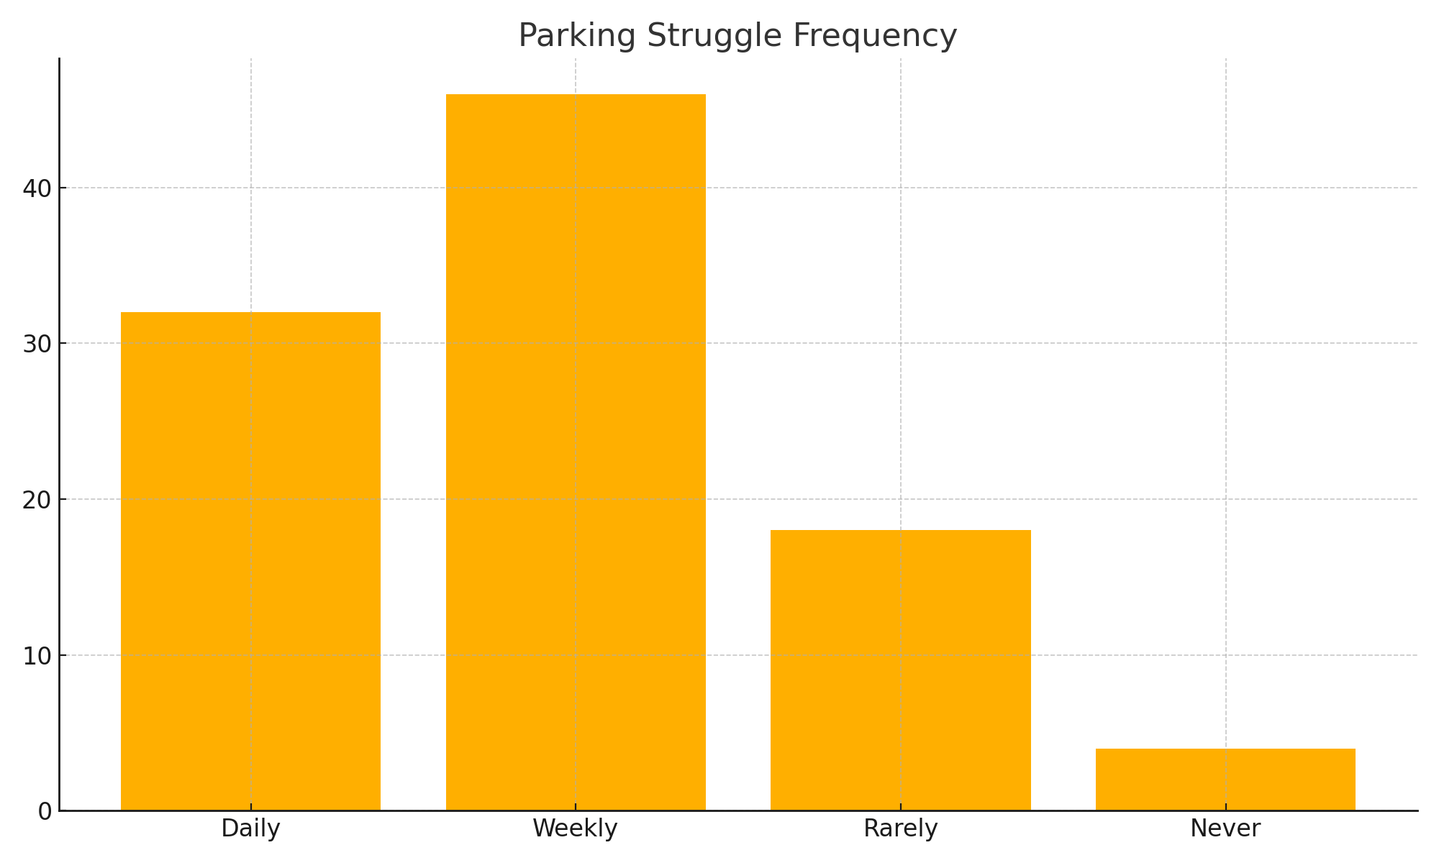
Parking Struggle Graph
01
02
03

Slide 5
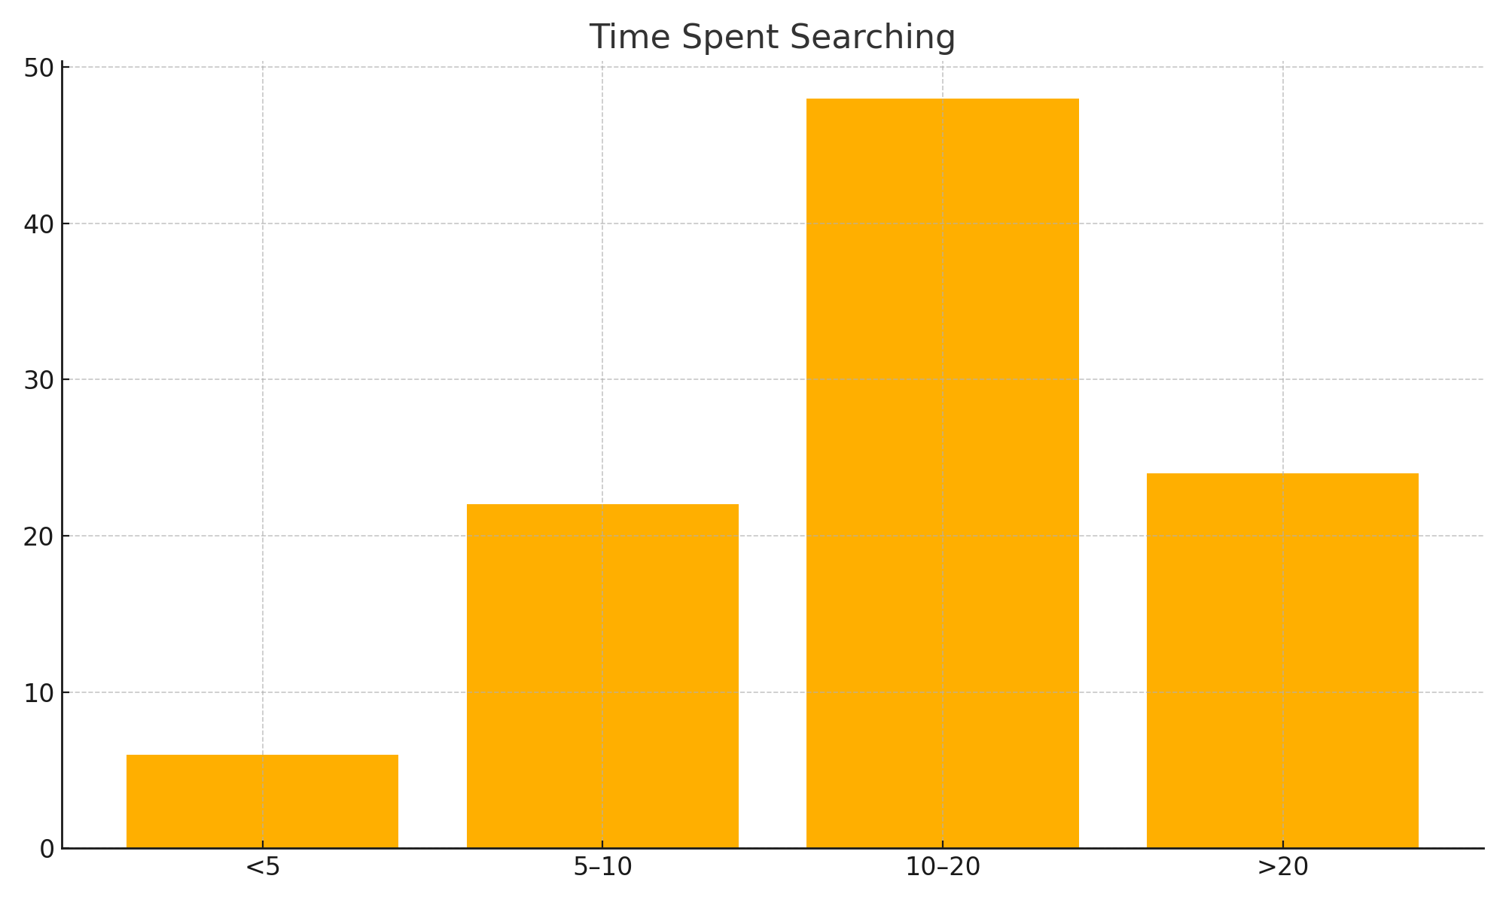
Time Spent to search for Parking

Slide 6

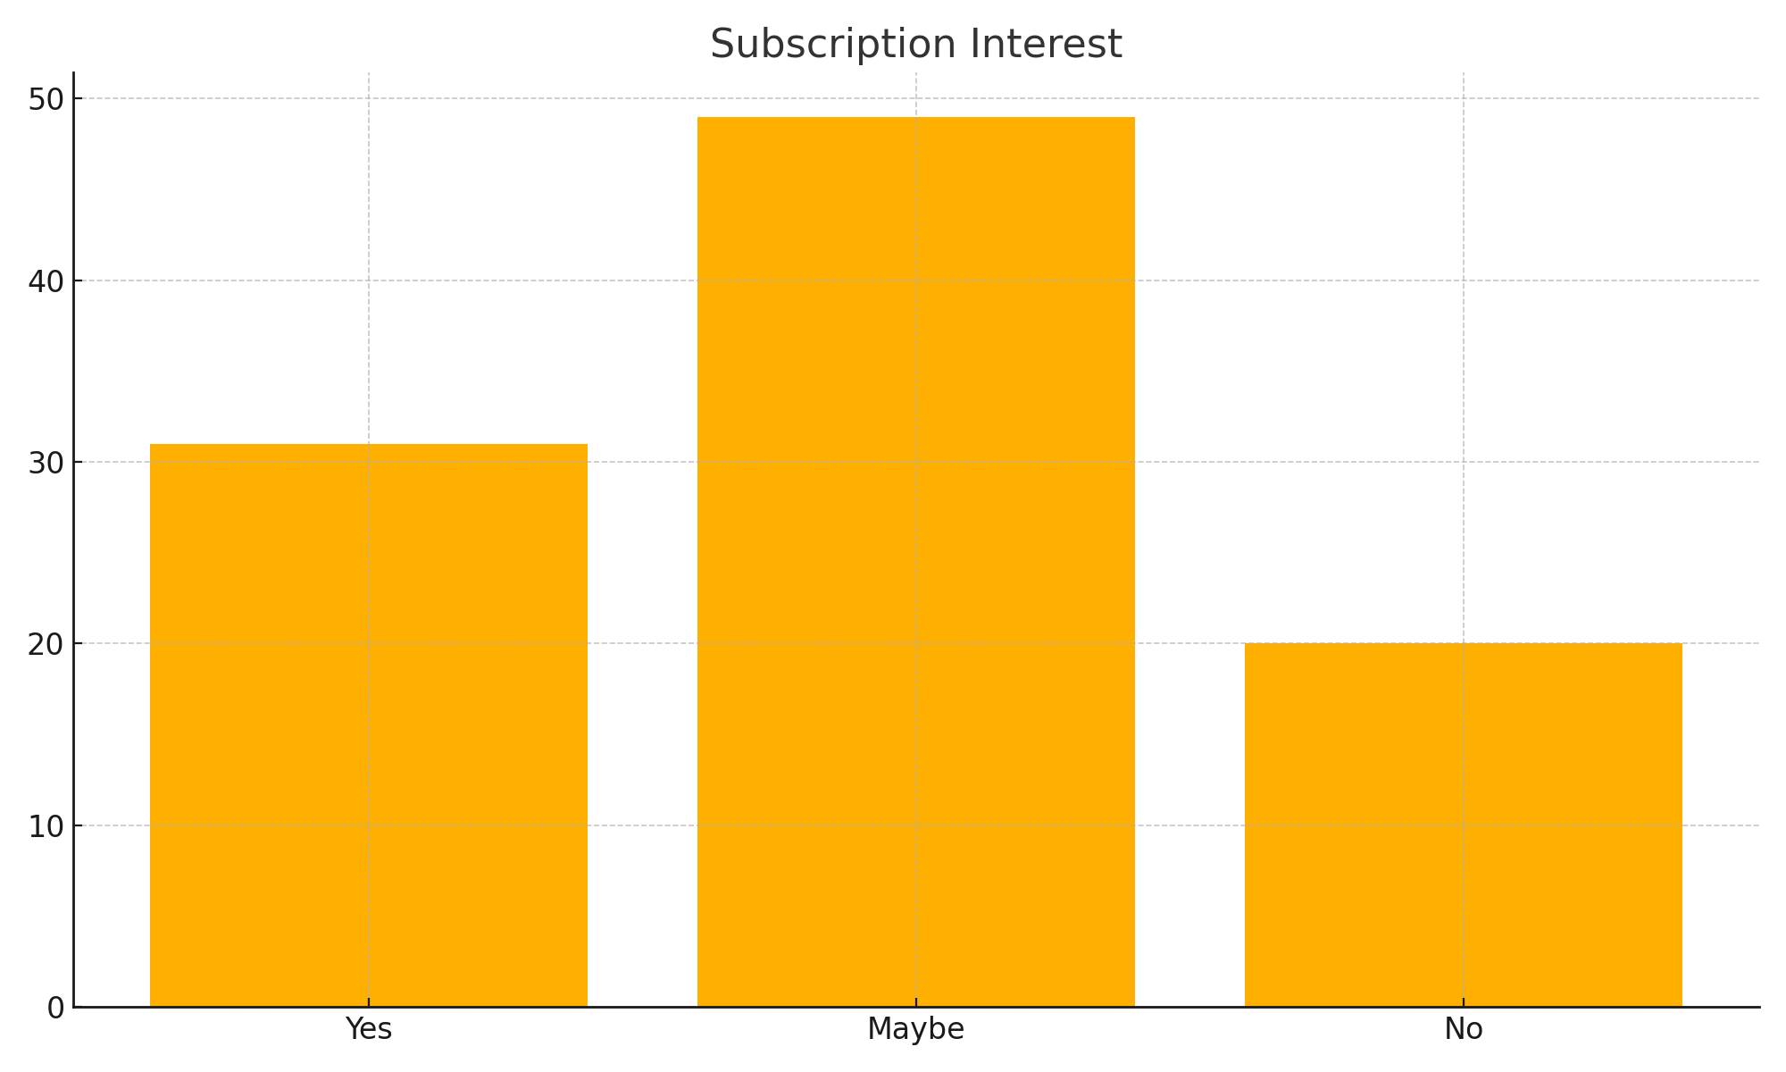


Subscription Interest

